Slide 1
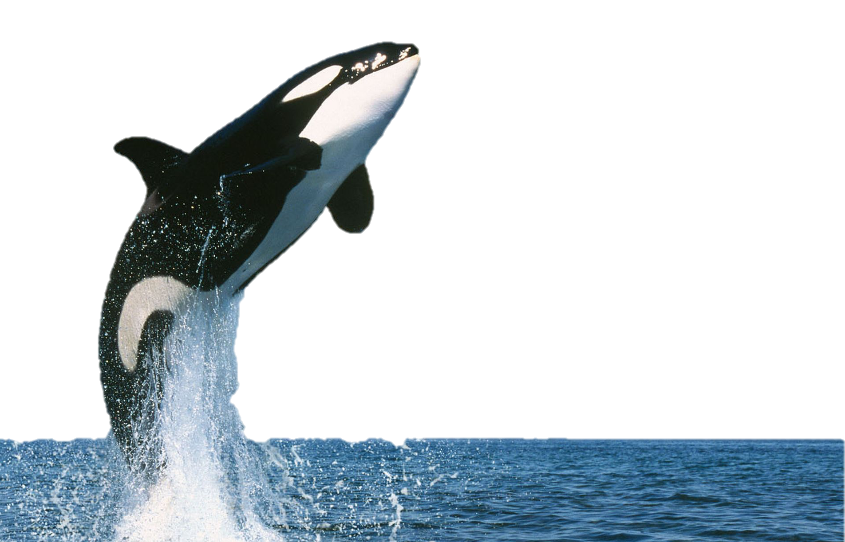
The Future of SeaWorld
University of Oxford

Slide 2
SeaWorld Past

Slide 3
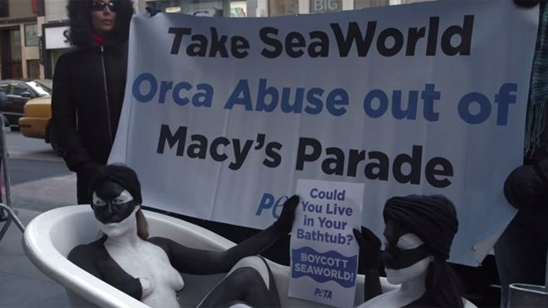
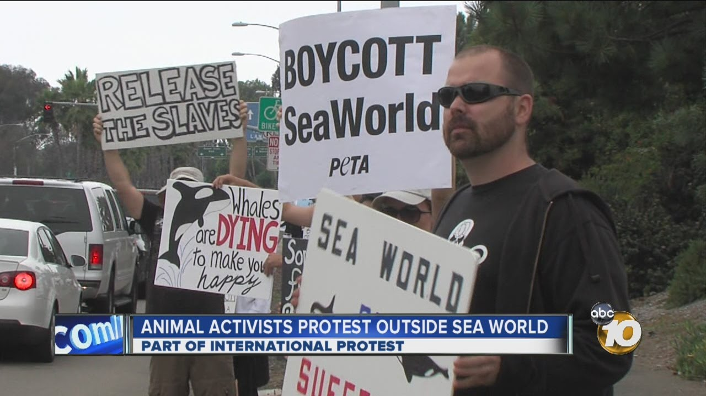
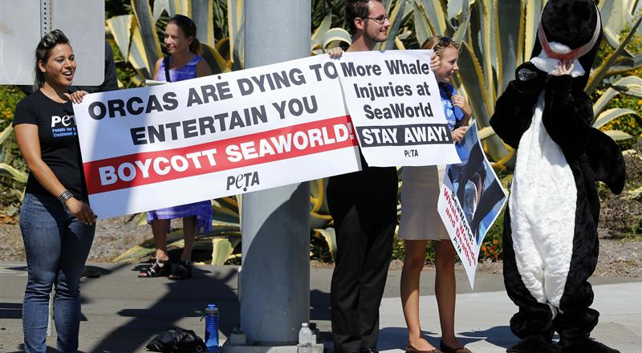
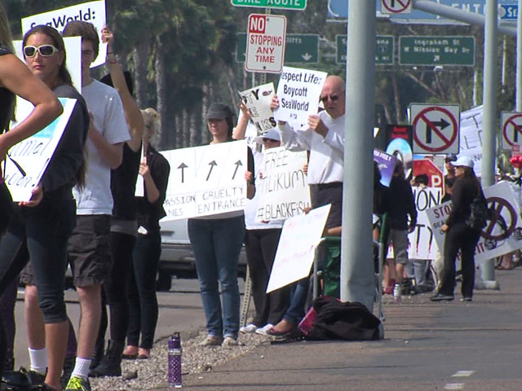
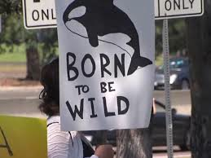
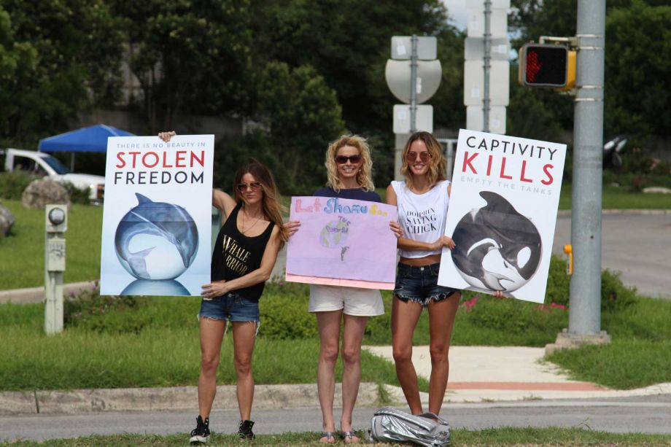
SeaWorld Past

Slide 4
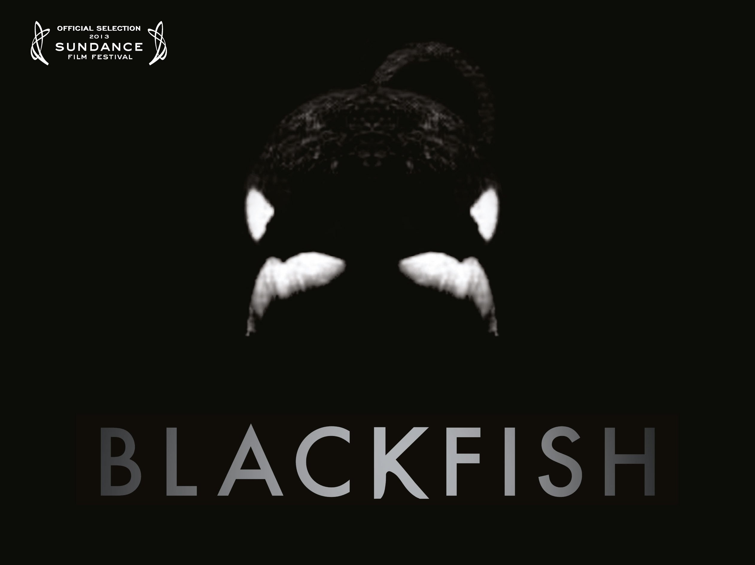
SeaWorld Present
Share Price (USD)

Slide 5
SeaWorld Present
Opportunity to pioneer a global change in the way we experience animals
Apparent paradox at the heart of our proposal
Proposal of revolutionary modern technology referred to as virtual and augmented reality

Slide 6
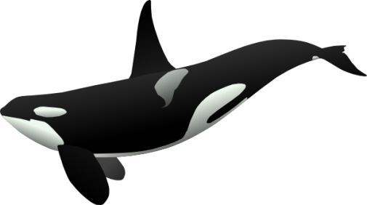
SeaWorld Future
Mark Zuckerberg on virtual reality:
“This is really a new communication platform… Imagine sharing not just moments with your friends online, but entire experiences and adventures.”

Slide 7
SeaWorld Future

Slide 8
Technologies Available
Augmented Reality
Live view of physical real-world environment whose elements are augmented by computer inputs
Virtual Reality
Computer generated simulation of 3D image which can be interacted with

Slide 9
Technologies Available
VR offers a digital recreation of a real life setting, whilst augmented reality delivers virtual elements
AR can be enjoyed in an arena as a group experience, where VR can be tailored to be a more personal experience
AR has the option for audience participation

Slide 10
Technologies Available

Slide 11
Integrate with Existing Rides

Slide 12
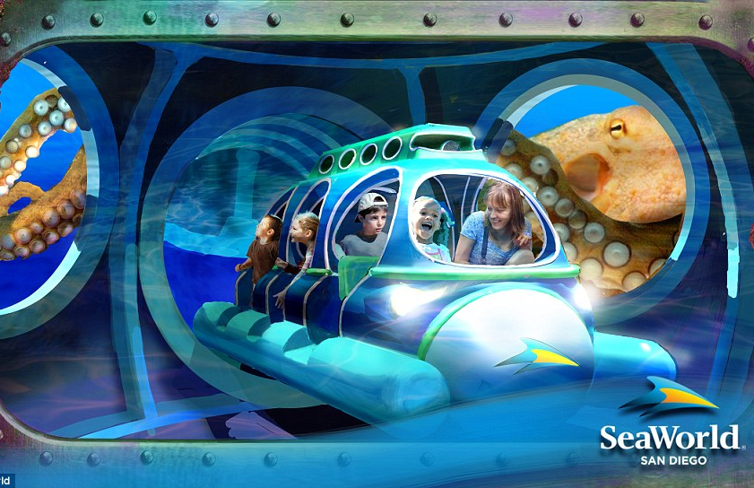
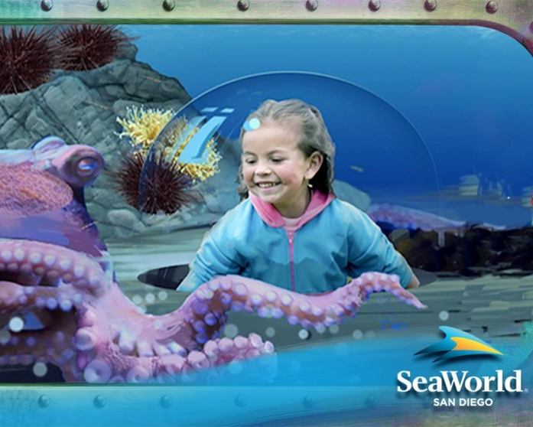
Integrate with Existing Rides

Slide 13
Use Existing Facilities

Slide 14
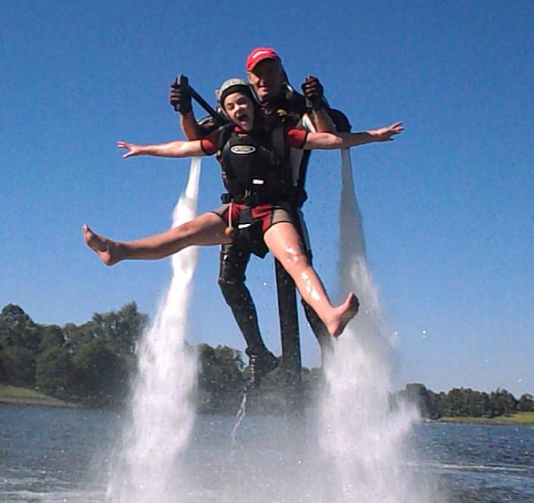
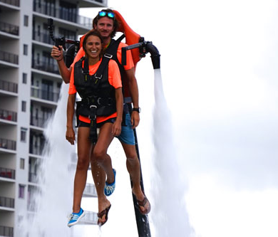
Use Existing Tanks

Slide 15
Numbers
Initial Investment
Core Engineering & Design Team | $4 mil/year
VR/AR Production Budget | $5 mil one-time investment
VR/AR Equipment | $10 mil one-time investment
Construction | $5 mil one-time investment
Technology Licensing | $5 mil/year
Advertising | Proportion of current budget
profit
Maintenance
On-Site Engineers | $2 mil/year
Other: Park attendants, cleaners etc. | Proportion of current budget
Advertising | Proportion of current budget
investment
Upgrade
VR/AR Production | $2 mil one-time investment
Installation | $0.5 mil one-time investment
Advertising | Proportion of current budget

Slide 16
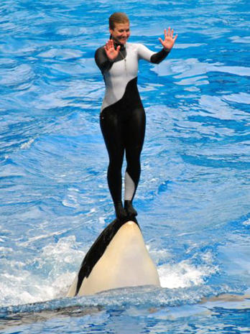
Safety of Trainers Cont.
Previous Legal Battles
OSHA ruled SeaWorld violated the "general clause" of Occupational Safety and Health Act by endangering human trainer
OSHA now forbids human trainers from interaction with captive whales unless separated by a physical barrier

Slide 17
Safety of Trainers Cont.
Previous Legal Battles
SeaWorld appealed ruling
Court upheld OSHA's ruling

Slide 18
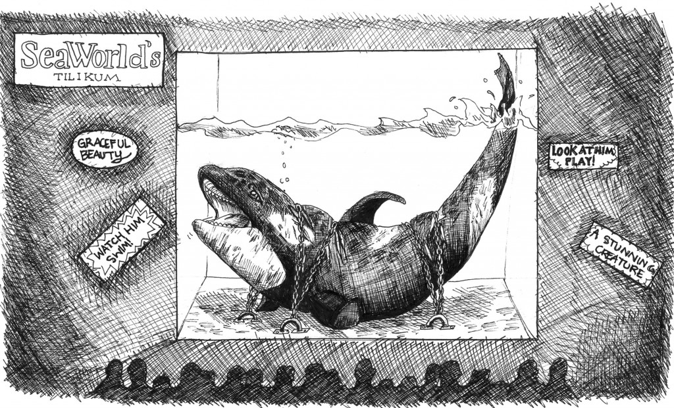
Ongoing Legal Battles
“False advertising” case dismissed, but…
It compared SeaWorld advertising to that of the tobacco industry
If public knew conditions of the captive orcas, visitors would not buy tickets to the theme park
Ruling upheld that:
SeaWorld is not obligated to disclose to ticket buyers how it trains or cares for orcas, just as any company is not required to disclose how it treats its workers
First time animals’ constitutional rights discussed in US court
But this could change. Let’s think ahead.

Slide 19
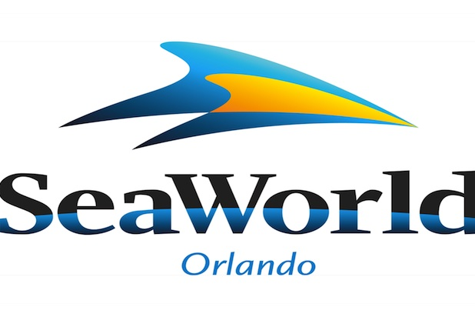
Our Solution
Our Solution
Surmountable legal issues
Addresses previous issues

Slide 20
Optimism
Optimism
Transform the brand
Please loyal supporters
Broaden consumer base
Re-frame discussions surrounding the global industry
Timeliness
Finding Dory
Cutting-edge technology
USP: experiential, educational, ecological

Slide 21
Financial & Ethical Imperative
Global shift in attitudes towards captivity for purposes of entertainment
2013 Indian government announcement
Ramifications of Blackfish
Government-public liaison
USDA commissions the revision of the Animal Welfare Act 2016
Call for revisions to the current standards

Slide 22
APHIS Proposal
Water treatment and bacteria levels
Accessibility to sufficient shaded areas
Air quality in indoor facilities
Compliance with AWA’s regulations on ‘interaction’
The amount of time animals should spend ‘on display’ versus ‘without public interaction’

Slide 23
APHIS Reaction
The current standards have not been revised since 1998
Pool dimension revisions not considered
Working to the new APHIS standards is important for the recovery of Sea World, but not in itself sufficient

Slide 24
Welfare Concerns
Psychological & physical deterioration
Social disintegration
Jacques Cousteau on captivity for dolphins:
“leads to a confusion of the entire sensory apparatus which in turn causes in such a sensitive creature a derangement of mental balance and behaviour”

Slide 25
Veterinary Concerns
Dr. Michael Hutchins on veterinary care:
“…There’s a clear pattern of preventable mortality as a result of factors controlled by zoo managers, exposures to toxins, extreme temperatures, injuries due to inappropriate social structure, starvation, poor nutrition, poor water quality etc.”

Slide 26
Zoochosis
Onset of psychosis associated with captivity
Ethically questionable training techniques
Starvation
Isolation

Slide 27
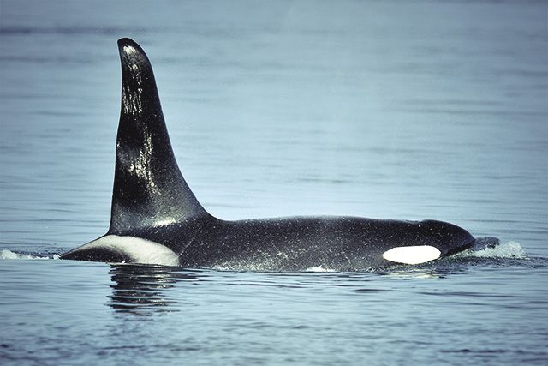
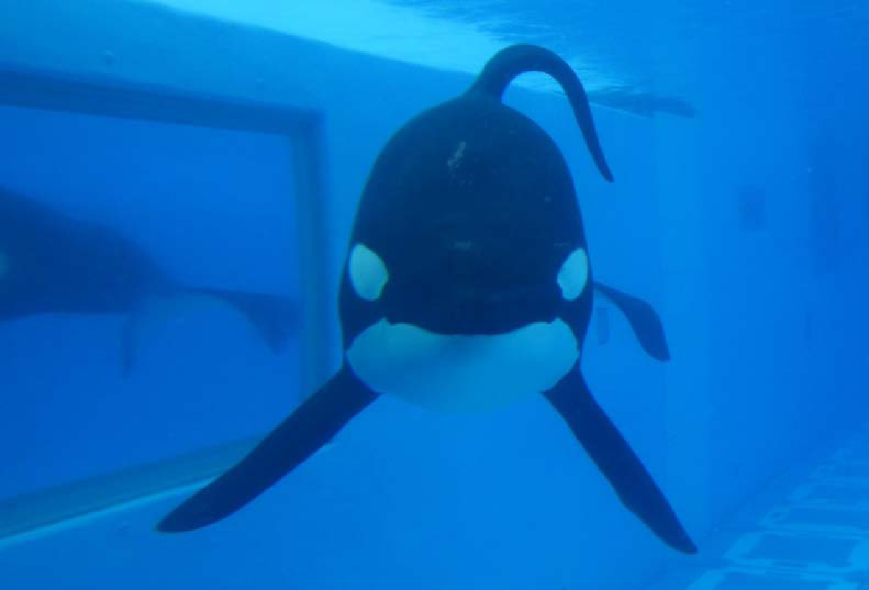
Ultimate Effects of Captivity
Drastically reduced life span
92% of SeaWorld’s orcas fail to live past 25 years
Traumatising weaning techniques
Zoochosis associated with aggression
Death of 4 human trainers
Dorsal collapse

Slide 28
The Future…
SeaWorld Entertainment using tomorrow’s technology today!
When you change the way you see the world, you change the world you see!

